Slide 1
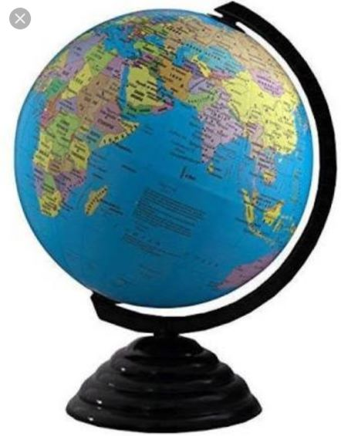
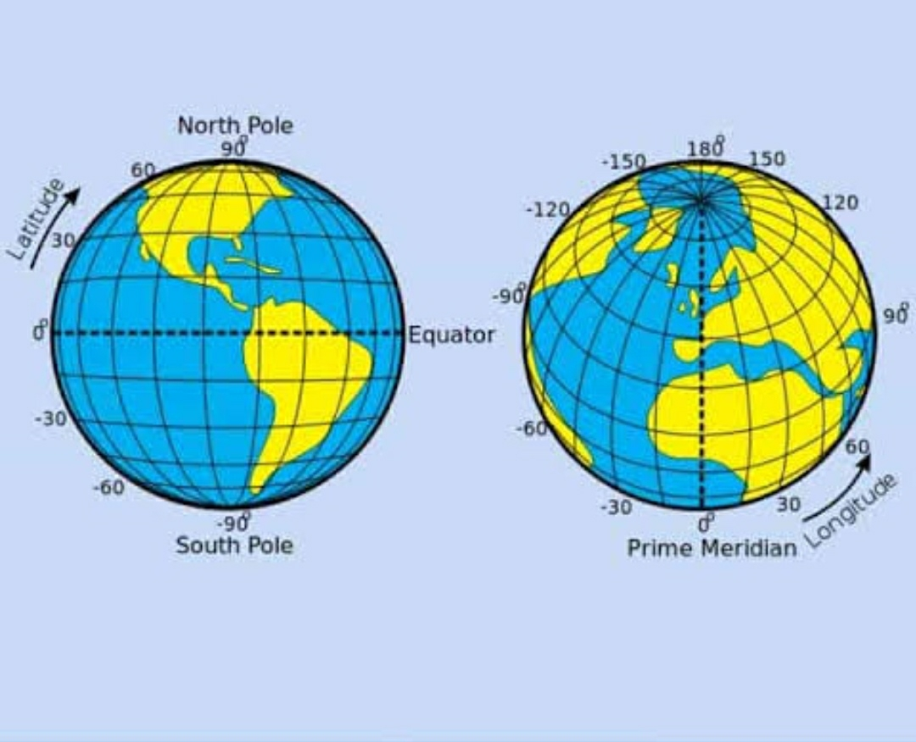
Globe: Latitudes and Longitudes
In Brief: The globe is the true representation of the Earth. Latitudes are the imaginary lines that runs horizontally across the globe. Longitudes are lines of equal length that runs vertically across the globe. The grid formed by latitudes and longitudes help us to locate places. With the help of latitudes we can understand the general climatic pattern of the world. Depending on the amount of heat received from the sun, the Earth is divided into the Torrid, Temperate and Frigid climatic Zones. Longitude help in the calculation of time. The meridian that runs through Greenwich ,England, is assigned 0˚ and is called the Prime Meridian. The Earth has been divided into 24 time zones: each zone differs from its neighbour by one hour. The International Date Line is a broken line drawn roughly along the 180˚ meridian: passengers crossing it gain or lose a day as they move from east to west and west to east, respectively.

